Slide 1
Renal System
Krishna Bastola
BSc.MLT, M.Sc.

Slide 2
Kidney
Kidney is an essential organ. It has several diverse functions.
Nephron is functional unit of kidney. It consists of glomerulus and renal tubules
Kidney maintains water, electrolyte and acid base balance of the body through filtration and reabsorption process. Glomerulus is responsible for filtration and renal tubules are involved in reabsorption. In addition renal tubules secretes some solute molecules.
Kidney clears several non-protein metabolic waste products like urea, uric acid, creatinine etc., from circulation.
Kidney produces erythropoietin, calcitriol, renin and prostaglandins.

Slide 3
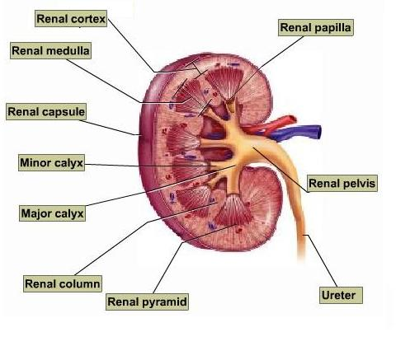

Slide 4
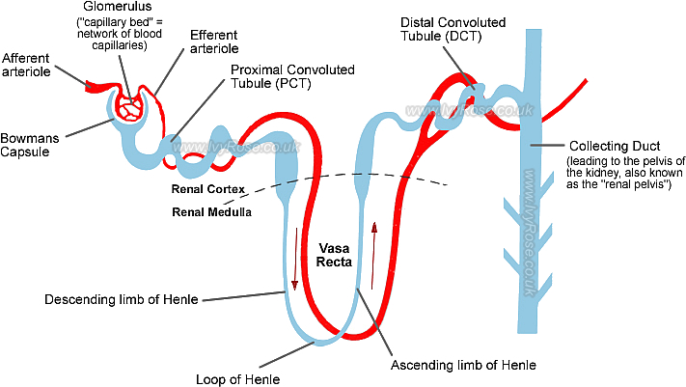
Fig: Parts of nephron.

Slide 5
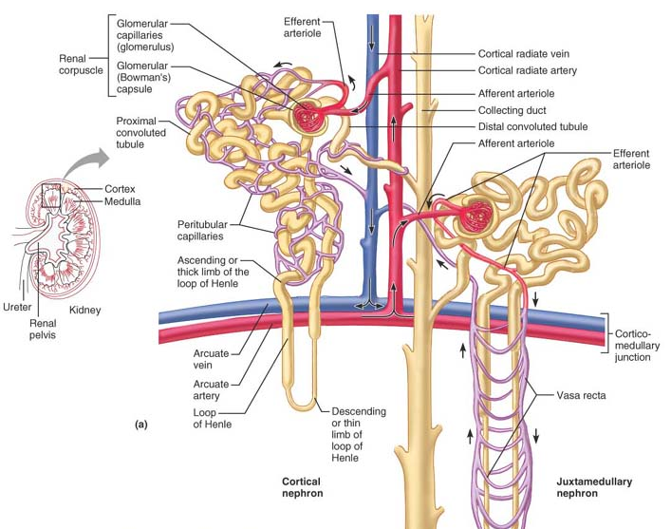

Slide 6
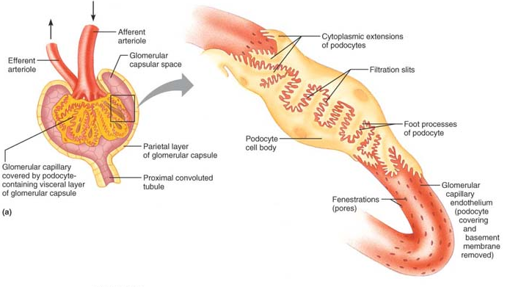
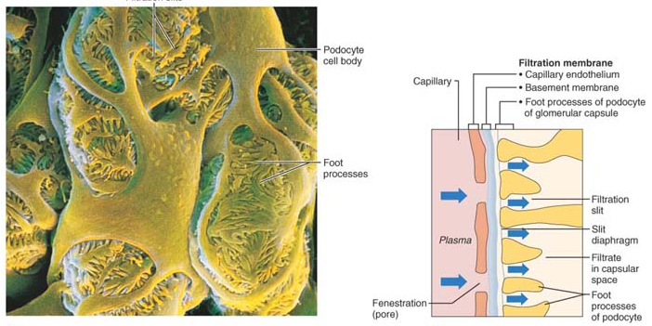

Slide 7
Glomerulonephritis

Slide 8
Introduction
Glomerulonephritis, also known as glomerular nephritis, is a renal disease characterized by inflammation of the glomeruli, or small blood vessels in the kidneys.
It may present with isolated hematuria and/or proteinuria or as a nephrotic syndrome
Classification
They are categorized into several different pathological patterns, which are broadly grouped into non-proliferative or proliferative types.
Causes
Primary causes: ones which are intrinsic to the kidney,
Secondary causes : associated with certain infections (bacterial, viral or parasitic pathogens), drugs, systemic disorders (SLE, vasculitis) or diabetes.

Slide 9
i. Non-Proliferative
This is characterized by the numbers of cells (lack of hypercellularity) in the glomeruli.
They usually cause nephrotic syndrome.
This includes the following types:
Minimal change GN
This form of GN causes 80% of nephrotic syndrome in children, but only 20% in adults.
As the name indicates, there are no changes visible on simple light microscopy, but on electron microscopy there is fusion of podocytes (supportive cells in the glomerulus).

Slide 10
Focal Segmental Glomerulosclerosis (FSGS)
Only certain foci of glomeruli within the kidney are affected, and then only a segment of an individual glomerulus.
Membranous glomerulonephritis
Membranous glomerulonephritis (MGN), a relatively common type of glomerulonephritis in adults, frequently produces a mixed nephrotic and nephritic picture.
Microscopically, MGN is characterized by a thickened glomerular basement membrane without a hypercellular glomerulus.

Slide 11
ii. Proliferative
This type is characterised by increased number of cells in the glomerulus (hypercellular).
Usually present as a nephritic syndrome and usually progress to end-stage renal failure (ESRF) over weeks to years.
Includes :
Post-infectious glomerulonephritis (Post infectious causes are group A beta-hemolytic streprococcal infection of the throat that proceeds the onset of GN by 2-3 weeks)
Membranoproliferative GN
Rapidly progressive glomerulonephritis
IgA nephropathy (Berger's disease) (macroscopic haematuria, visibly bloody urine). There is focal area of inflammation.

Slide 12
Nephritic Syndrome

Slide 13
Introduction
Nephritic syndrome (or acute nephritic syndrome) is a collection of signs (known as a syndrome) associated with disorders affecting the kidneys, more specifically glomerular disorders.
It's characterized by having small pores in the podocytes of the glomerulus, large enough to permit proteins (proteinuria) and red blood cells (hematuria) to pass into the urine.
result in hypoalbuminemia due to protein albumin moving from the blood to the urine.
Hematuria can be caused by bleeding anywhere in the urinary tract, but if the RBCs are trapped in urinary casts, it is more likely that the bleeding originated in the nephron.

Slide 14
Signs and symptoms (clinical features)
Nephritic syndrome is characterized by;
hematuria (blood in the urine), with red blood cell (RBC) casts present in the urine
proteinuria (protein in the urine) - small amounts of protein are lost in the urine
hypertension (high blood pressure)- mild
uremia - due to retention of waste products and variable renal insufficiency, with;
azotemia (elevated blood nitrogen; urea, creatinine)
oliguria (low urine output <400 mL/day)
The main features are hypertension and RBC casts.
The proteinuria in nephritic syndrome is not usually severe, but may occasionally be heavy enough to be in the range usually found in nephrotic syndrome.

Slide 15
Diagnosis
An anti-streptolysin O titre (or ASOT) is typically done to test for exposure to streptococci. This test however has incredibly poor specificity.
Biochemical investigations: BUN (urea, creatinine)
Pathophysiology
The exact pathophysiology is dependent on the specific diagnosis.
However, the common features are an inflammation of the glomeruli, leading to salt and water retention and a reduction in the kidney function.
Classification
The two classic diagnoses of nephritic syndrome are:
post-streptococcal glomerulonephritis
crescentic glomerulonephritis (also called rapidly progressive glomerulonephritis)

Slide 16
Pathophysiology:
Antigen (group A beta-hemolytic streptococcus)
Ag-Ab product
Deposit of Ag-Ab complex in glomerulus
Increased production of epithelial cells lining the glomerulus
Leucocytes infiltration of the glomerulus
Thickening of glomerular filtration membrane
Scarring and loss of glomerular filtration membrane
Decreased GFR (glomerular filtration rate)

Slide 17
Glomerular Filtration Rate (GFR):
About 1200 ml of blood (650 ml plasma) passes through the kidneys, every minute.
From this, about 120-125 ml is filtered per minute by the kidneys and this is referred to as glomerular filtration rate (GFR).

Slide 18
Nephrotic syndrome

Slide 19
Introduction
Nephrotic syndrome is a non-specific disorder in which the
kidneys are damaged
causing them to leak large amounts of protein (proteinuria at least 3.5 grams per day) from the blood into the urine, leading to hypoalbuminemia.
Kidneys affected by nephrotic syndrome have
small pores in the podocytes
large enough to permit proteinuria (and subsequently hypoalbuminemia, because some of the protein albumin has gone from the blood to the urine)
but not large enough to allow cells through (hence no hematuria).

Slide 20
Etiology/Causative factor
Primary glomerular disease
Minimal change GN
Focal Segmental Glomerulosclerosis (FSGS)
Membranous glomerulonephritis
IgA nephrophathy
Systemic disease with renal manifestations
DM
SLE
Drugs
Infections
Sickle cell disease

Slide 21
Signs and symptoms (clinical features)
The most common sign is excess fluid in the body. This may take several forms:
Puffiness around the eyes, characteristically in the morning.
Edema over the legs which is pitting (i.e., leaves a little pit when the fluid is pressed out, which resolves over a few seconds).
Fluid in the pleural cavity causing pleural effusion.
More commonly associated with excess fluid is pulmonary edema.
Fluid in the peritoneal cavity causing ascites.
A generalized edema throughout the body known as anasarca
Hypertension (rarely)
Proteinuria, hypoalbuminaemia
Decreased urinary output

Slide 22
Signs and symptoms (clinical features)
Some patients may notice foamy urine, due to a lowering of the surface tension by the severe proteinuria.
Actual urinary complaints such as hematuria or oliguria are uncommon, and are seen commonly in nephritic syndrome.

Slide 23
Diagnosis
The following are baseline, essential investigations
Urine sample shows proteinuria (>3.5 gm per 24 hour).
It is also examined for urinary casts; which is more a feature of active nephritis.
Hypoalbuminemia: albumin level ≤2.5 g/dL (normal=3.5-5 g/dL).
High levels of cholesterol (hypercholesterolemia), specifically elevated LDL, usually with concomitantly elevated VLDL
Electrolytes, urea and creatinine (EUCs): to evaluate renal function
Further investigations are indicated if the cause is not clear
Biopsy of kidney
Auto-immune markers (ANA, ASOT, C3, serum electrophoresis)

Slide 24
Pathophysiology:
Causative factor
Glomerular damage
Increased permeability of glomerular capillaries to proteins
Proteinuria
Hypoalbuminemia
Decreased osmotic pressure
Compensatory synthesis of protein
Fluid escape into tissues
Decreased plasma volume
hyperlipidemia
Decreased GFR
Edema
Aldosterone secretion
Fluid retention

Slide 25
Renal failure

Slide 26
Introduction
Renal failure or kidney failure is a situation in which the kidneys fail to function adequately.
It is divided into acute and chronic forms; either form may be due to a large number of other medical problems.
Biochemically, it is typically detected by an elevated serum creatinine and also urea.
Physiologically, renal failure is described as a decrease in the glomerular filtration rate.
When the kidneys malfunction, problems frequently encountered are abnormal fluid levels in the body, deranged acid levels, abnormal levels of potassium, calcium, phosphate, hematuria (blood in the urine) and (in the longer term) anemia.

Slide 27
Classification
The type of renal failure is determined by
the trend in the serum creatinine
the presence of anemia
the kidney size on ultrasound.
Chronic kidney disease generally leads to anemia and small kidney size.
Acute kidney injury
Acute kidney injury (AKI), previously called acute renal failure (ARF), is a rapidly progressive loss of renal function, generally characterized by
oliguria (decreased urine production, quantified as less than
400 mL per day )
body water and body fluids disturbances;
electrolyte derangement.
AKI can result from a variety of causes, generally classified as
prerenal (prior to involvement of kidney)
intrinsic (relating to kidney)
postrenal (relating to obstruction of urine flow)

Slide 28
Chronic kidney disease
Chronic kidney disease (CKD) can develop slowly and show few initial symptoms, be the long term result of irreversible acute disease, or be part of a disease progression.
Symptoms
Symptoms of kidney disease can vary from person to person.
Some people with kidney disease may not even feel sick, or they may not notice their symptoms.
If the kidney function fails, the waste products (urea, creatinine) accumulate in the blood and the body, termed azotemia.
Very mild levels of azotaemia may produce little or no symptoms, but if the kidney failure continues then symptoms will become noticeable
Renal failure accompanied with noticeable symptoms is termed uraemia.

Slide 29
Pathophysiology:
Deterioration and destruction of the nephrons
Decline in renal function (GFR and clearance)
End product of protein metabolism (urea) and creatinine accumulation in the blood
Urine concentrating ability of the kidney lost
Body becomes unable to get rid of excess water, salt and other waste products
Uremia develops and adversely affects every system in the body
Greater the build-up of waste products, the more pronounced the systems

Slide 30
Symptoms of kidney failure include
1. High levels of urea in the blood, which can result in:
Vomiting and/or diarrhea, which may lead to dehydration
Nausea
Weight loss
Foamy or bubbly urine
More frequent urination, or in greater amounts than usual, with pale urine
Less frequent urination, or in smaller amounts than usual, with dark coloured urine
Blood in the urine
Pressure, or difficulty urinating
2. A build up of potassium in the blood that diseased kidneys cannot filter out (called hyperkalemia) may cause:
Abnormal heart rhythms
Muscle paralysis

Slide 31
3. A build up of phosphates in the blood that diseased kidneys cannot filter out may cause:
Itching
Bone damage
Muscle cramps (caused by low levels of calcium which can cause hypocalcaemia)
4. Failure of kidneys to remove excess fluid may cause:
Swelling of the legs, ankles, feet, face and/or hands
5. Shortness of breath due to extra fluid on the lungs (may also be caused by anemia), Polycystic kidney disease, which causes large, fluid-filled cysts on the kidneys and sometimes the liver
6. Pain in the back or side

Slide 32
Causes
Acute renal failure
Acute kidney failure usually occurs as the result of a sudden interruption in the blood supply to the kidney, or as a result of a toxic overload of the kidneys.
Some causes of acute failure include accidents, injuries or complications from surgery where the kidneys are deprived of normal blood flow for an extended period of time.
Drug overdoses, whether accidental or from chemical overloads of drugs such as antibiotics or chemotherapy, may also cause the onset of acute kidney failure.
Unlike in chronic kidney disease, however, the kidneys can often recover from acute failure, allowing the patient to resume a normal life.
People suffering from acute failure require supportive treatment until their kidneys recover function, and they often remain at an increased risk of developing future kidney failure.

Slide 33
Causes
Chronic kidney disease
There are many causes of CKD. The most common cause is diabetes mellitus.
The second most common cause is long-standing, uncontrolled, hypertension.
Polycystic kidney disease is also a well known cause of chronic kidney disease.
Many other genetic illnesses also affect kidney function.
Overuse of some common drugs, such as aspirin, ibuprofen, cocaine and acetaminophen can also cause chronic kidney damage.

Slide 34
Investigation
Stages of Chronic kidney failure is measured in five stages, which are calculated using a patient’s glomerular filtration rate.
Stage 1 CKD is mildly diminished renal function, with few overt symptoms.
Stages 2 and 3 need increasing levels of supportive care from their medical providers to slow and treat their renal dysfunction.
Patients in stages 4 and 5 usually require preparation of the patient towards active treatment in order to survive.
Stage 5 CKD is considered a severe illness and requires some form of renal replacement therapy (dialysis) or kidney transplant whenever feasible.

Slide 35
Polycystic Kidney

Slide 36
Polycystic Kidney
An inherited disease in which the kidneys contain many cysts.
It may be congenital or acquired, non-neoplastic or neoplastic. Majority of these lesions are congenital non-neoplastic.
These grow in size until normal kidney tissue is largely destroyed.
In adults, the disease will cause hypertension and kidney failure. There is also a juvenile form.
There is no effective treatment, although symptoms can be alleviated by dialysis and sometimes kidney transplant

Slide 37
Polycystic disease of the kidney (PKD) is a disorder in which major portion of the renal parenchyma is converted into cysts of varying size.
The disease occurs in two forms:
An adult type inherited as an autosomal dominant disease;
An infantile type inherited as an autosomal recessive disorder.
Adult Polycystic Kidney Disease:
Adult polycystic kidney disease is characterized by multiple expanding cysts affecting both kidneys that ultimately destroy the intervening parenchyma.
It is seen in approximately 1 in 500 to 1000 persons and accounts for 10% of cases of chronic kidney disease.

Slide 38
Morphology:
Kidney may reach enormous size, and weights of up to 4 kg
Very large kidneys are readily palpable abdominally as masses extending into the pelvis.
On gross examination the kidney composed solely of a mass of cysts of various sizes up to 3 or 4 cm in diameter
Cysts are filled with fluid, which may be clear, turbid, or hemorrhagic
Cysts may arise at any level of the nephron, from tubules to collecting ducts
Occasionally, Bowman’s capsules are involved in the cyst formation
Evidence of superimposed hypertension or infection is common

Slide 39
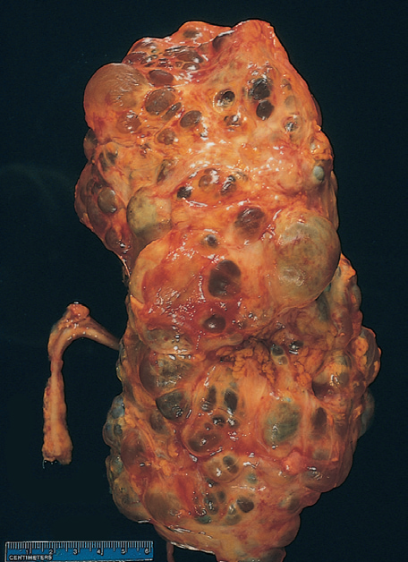
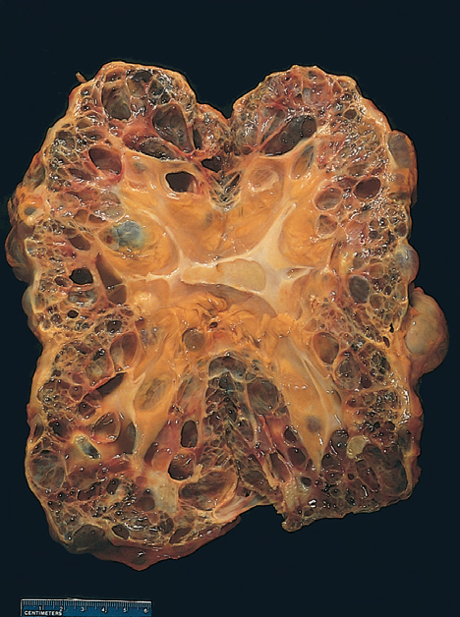
Fig: Adult polycystic kidney, viewed from the external surface (A) and bisected (B). The kidney is markedly enlarged with numerous dilated cysts.

Slide 40
Clinical Features:
The condition may become clinically apparent at any age but most commonly manifests in 3rd to 5th decades of life.
The most common presenting complaint is flank pain
Acute distension of a cyst, either by intracystic hemorrhage or by obstruction, may cause excruciating pain.
The presenting complaints are haematuria or passage of blood clots in urine, renal colic, hypertension, urinary tract infections and progressive CRF with polyuria and proteinuria.

Slide 41
Infantile Polycystic Kidney Disease:
The infantile (autosomal recessive) form of polycystic kidney disease (ARPKD) is distinct from the adult form and is less common (incidence 1:20,000 births).
The condition occurs due to a mutation in chromosome 6-6p21.

Slide 42
MORPHOLOGY
Numerous small cysts in the cortex and medulla give the kidney a sponge-like appearance.
Dilated, elongated channels completely replace the medulla and cortex.
The cysts have a uniform lining of cuboidal cells, reflecting their origin from the collecting tubules.
In almost all cases, findings include multiple epithelium-lined cysts.

Slide 43
Clinical Features:
Perinatal and neonatal forms are most common; serious manifestations usually are present at birth, and young infants may die quickly from hepatic or renal failure.
Patients may develop liver cirrhosis (congenital hepatic fibrosis).

Slide 44
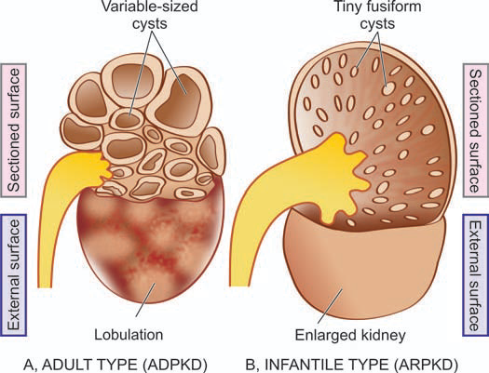
Fig: Polycystic kidney disease. Diagrammatic representation of comparison of gross appearance of the two main forms.

Slide 45
Urinary Tract Infection

Slide 46
Definitions
UTI : Inflammatory response of the urinary tract to bacterial invasion
Bacteriuria: Presence of the bacteria in the urine (1,00,000 cfu/ml)
Pyuria : presence of white blood cell (pus cell) in urine
Less than 10,000 organisms/ml (10⁴/ml), not significant.
10,000–100,000/ml (10⁴–10⁵/ml), doubtful significance (suggest repeat specimen)
More than 100,000/ml (10⁵/ml), significant bacteriuria.

Slide 47
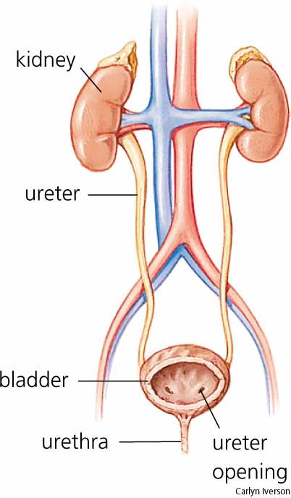
Types of UTI:
Lower UTI: Urethritis, Cystitis
Upper UTI: Pyelonephritis

Slide 48
Factors limiting multiplication of organism
- Flushing action of urine
- Acidic pH of urine
- Regular bladder emptying
- Constant dilution of residual urine in bladder
- Mucosal defenses
- Secretion of prostate & periurethral glands

Slide 49
Factors favoring multiplication of organism
Obstruction to urine flow
Glucose in urine
Alkaline pH

Slide 50
Clinical features:
Asymptomatic bacteriuria (Covert bacteriuria):
- Pregnant ladies.
- Girls (1-3)%.
- Detected by urine culture

Slide 51
Symptomatic UTI
Clinical features:
Dysuria, frequency, urgency
Cloudy and foul smell urine
Hematuria
Suprapubic pain, loin pain
Fever, nausea, vomiting

Slide 52
Prevalence of urinary tract infections (UTI)
Females are much more affected than males
It is estimated that (20-30)% will have at least one UTI in their live.
Risk of UTI in women increases after menopause.
After a UTI: 20-40 % will have a recurrence.

Slide 53
Prevalence of urinary tract infections (UTI)
UTI is rare in young and middle-aged men
UTI in men is often associated with :
Underlying pathology
Catheterisation
Urological procedures.
Urinary catheter increases the risk of UTI:
- Pseudomonas is commonly encountered organism.

Slide 54
Risk factors

Slide 55
Women in general
Pregnant women
Sexually active women
Abnormality of normal flow of urine
Enlarged prostate, Kidney stones
Vesicoureteral reflux
Neurogenic bladder
Indwelling urinary catheters
Compromised immune function:
Diabetes, Immunosupressive drugs.

Slide 56
UTI more common in females ??
Female urethra: - Short length.
- Proximity to anus.
Sexual intercourse.
Pregnancy:
- Dilatation of ureters and renal pelvis.
- Temporary incompetence of vesico-urethral valves.

Slide 57
Pathogenesis of UTIs
Urinary tract infection occurs when bacteria which colonise the anal area ascend through urethra to the bladder

Slide 58
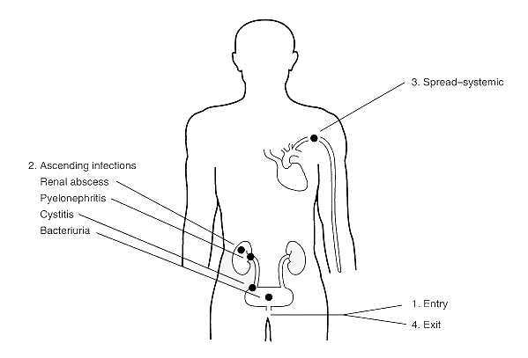
Route of infection:
Ascending infection
Haematogenous infection

Slide 59
Route of infection:
Ascending infection
Bacteria in perineal area ascends through the urethra, enters the urinary bladder and multiplies
Most common route of infection
e.g. E. coli to the bladder

Slide 60
Route of infection:
Haematogenous infection:
Patient with bacteremia, bacteria may be “seeded” into the kidneys from the blood
e.g. Staph aureus, T.B

Slide 61
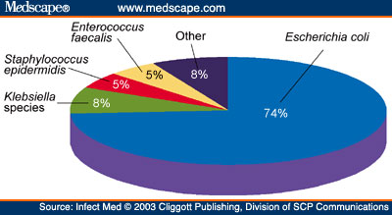
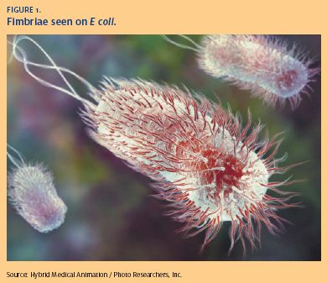
Causative agents of UTIs:

Slide 62
Causative agents of UTIs
Escherichia coli
most common
about 80% of primary care infections
about 50% of hospital-acquired infections

Slide 63
Causative agents of UTIs
Others:
Enterococci, S. aureus
Klebsiella species
Staphylococcus saprophyticus
various types of pseudomonas and proteus are more rare.
Fungi: Candida species.

Slide 64
‘Complicated’ or ’uncomplicated’?
‘Uncomplicated’ urinary tract infections are
Lower urinary tract infections in women with no predisposing factors to infections
‘Complicated’ infections are all other UTIs including lower UTIs in
Pregnant women
Men
Children
Catheter-induced infections

Slide 65
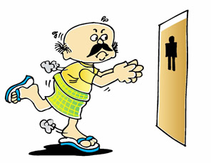
Clinical features of UTI
Cystitis
Frequency
Urgency
Dysuria – painful voiding
Suprapubic Pain
Cloudy or foul-smelling urine

Slide 66
Clinical features of UTI
Acute pyelonephritis
Loin pain and tenderness
High Fever and chills
Nausea and vomiting
Malaise

Slide 67
Pathophysiology:
Causative agents (E. coli, Klebsiella, staphylococcus, etc.)
Enter the bladder through the urethra
Bacteria attach to the bladder wall
Forms the biofilm that resist the body’s immune response
Leads to infection

Slide 68
Nephrolithiasis / Urolithiasis (Renal Calculi)

Slide 69
Nephrolithiasis /Urolithiasis (Renal Calculi)
Nephrolithiasis or urolithiasis is formation of urinary calculi at any level of the urinary tract.
It is estimated that approximately 2% of the population experiences renal stone disease at sometime in their life with male-female ratio of 2:1.
The peak incidence is observed in 2nd to 3rd decades of life.
Renal calculi are characterised clinically by colicky pain (renal colic) as they pass down along the ureter and manifest by haematuria.

Slide 70
Nephrolithiasis /Urolithiasis (Renal Calculi)
Types of Urinary Calculi:
There are 4 main types of urinary calculi :-
Calcium containing,
Mixed (struvite),
Uric acid
Cystine stones, and a few rare types

Slide 71
Calcium Stones
Most common comprising about 75% of all urinary calculi.
May be pure stones of calcium oxalate (50%) or calcium phosphate (5%), or mixture of calcium oxalate and calcium phosphate (45%)
Etiology:
idiopathic hypercalciuria without hypercalcaemia (50%)
hypercalcaemia and hypercalciuria (10%) most commonly due to hyperparathyroidism, or a defect in the bowel (i.e. absorptive hypercalciuria), or in the kidney (i.e. renal hypercalciuria)
hyperuricosuria (15%) with a normal blood uric acid level and without any abnormality of calcium metabolism
idiopathic calcium stone disease (25%)

Slide 72
Pathogenesis:
The cause of stone formation is often obscure, particularly in the case of calcium-containing stones.
Probable predisposing conditions, including the concentration of the solute, changes in urine pH, and bacterial infections.
The most important cause is increased urinary concentration of the stone’s constituents, so that it exceeds their solubility in urine (supersaturation).
50% of patients who develop calcium stones have hypercalciuria that is not associated with hypercalcemia.
Most in this group absorb calcium from the gut in excessive amounts (absorptive hypercalciuria) and promptly excrete it in the urine, and some have a primary renal defect of calcium reabsorption (renal hypercalciuria).

Slide 73
Morphology
Calcium stones are usually small (less than a centimeter), ovoid, hard, with granular rough surface.
They are dark brown due to old blood pigment deposited in them as a result of repeated trauma caused to the urinary tract by these sharp-edged stones.

Slide 74
Mixed (Struvite) Stones
About 15% of urinary calculi are made of magnesium-ammonium-calcium phosphate, often called struvite; hence mixed stones are also called as ‘struvite stones’ or ‘triple phosphate stones’.
Etiology
Struvite stones are formed as a result of infection of the urinary tract with urea-splitting organisms that produce urease such as by species of Proteus, and occasionally Klebsiella, Pseudomonas and Enterobacter.
These are, therefore, also known as infection-induced stones. However, E. coli does not form urease.

Slide 75
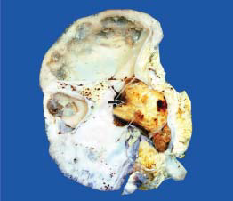
Morphology
Struvite stones are yellow-white or grey.
They tend to be soft and friable and irregular in shape.
‘Staghorn stone’ which is a large, solitary stone that takes the shape of the renal pelvis where it is often formed is an example of struvite stone
Fig: Staghorn renal stone with chronic pyelonephritis. The kidney is enlarged and heavy.

Slide 76
Uric Acid Stones
Approximately 6% of urinary calculi are made of uric acid. Uric acid calculi are radiolucent unlike radio-opaque calcium stones.
Etiology
Uric acid stones are frequently formed in cases with hyperuricaemia and hyperuricosuria such as due to primary gout or secondary gout, administration of uricosuric drugs (e.g. salicylates, probenecid), etc.
Other factors contributing to their formation are acidic urinary pH (below 6) and low urinary volume.

Slide 77
Pathogenesis:
The solubility of uric acid at pH of 7 is 200 mg/dl while at pH of 5 is 15 mg/dl.
Thus, as the urine becomes more acidic, the solubility of uric acid in urine decreases and precipitation of uric acid crystals increases favouring the formation of uric acid stones.
Hyperuricosuria is the most important factor in the production of uric acid stones, while hyperuricaemia is found in about half the cases.
Morphology
Uric acid stones are smooth, yellowish-brown, hard and often multiple.
On cut section, they show laminated structure.

Slide 78
Cystine Stones
Cystine stones comprise less than 2% of urinary calculi.
Etiology
Cystine stones are associated with cystinuria due to a genetically-determined defect in the transport of cystine and other amino acids across the cell membrane of the renal tubules and the small intestinal mucosa.
Pathogenesis
The resultant excessive excretion of cystine which is least soluble of the naturally-occurring amino acids leads to formation of crystals and eventually cystine calculi.
Morphology
Cystine stones are small, rounded, smooth and often multiple.
They are yellowish and waxy.

Slide 79
Other Calculi
Less than 2% of urinary calculi consist of other rare types such as due to inherited abnormality of enzyme metabolism e.g. hereditary xanthinuria developing xanthine stones.
Sign and symptoms of renal calculi
Renal colic
Urinary urgency
Restlessness
Hematuria
Sweating
Nausea and vomiting
Post renal azotemia
Hydronephrosis

Slide 80
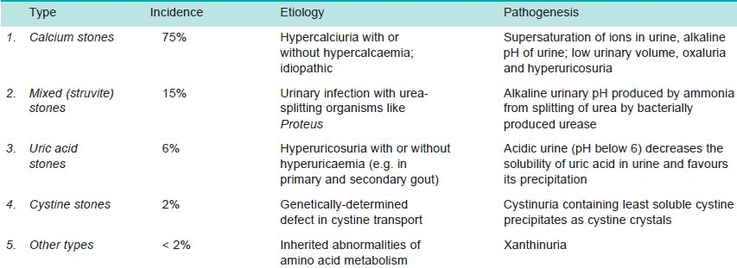
Table: Salient Features of Urinary Calculi.

Slide 81
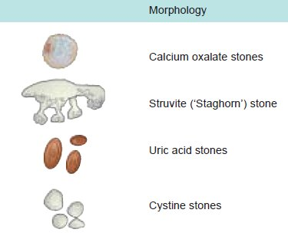

Slide 82
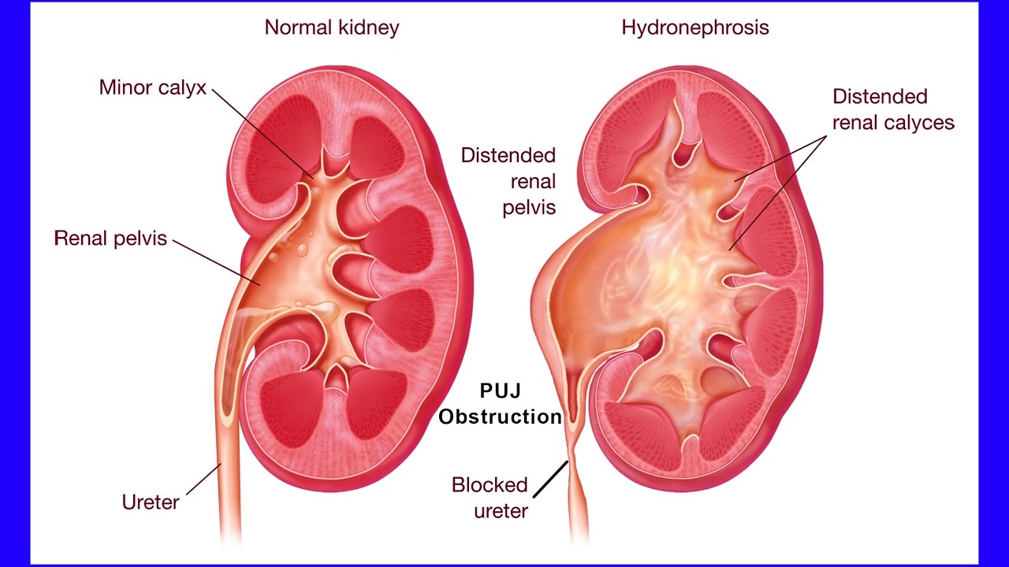
Hydronephrosis
Pelvi-ureteric junction (PUJ)

Slide 83
Hydronephrosis
Chronic disease; kidney becomes greatly distended with fluid.
Caused by obstruction to the flow of urine at the pelvi-ureteric junction (PUJ).
If the ureter is obstructed, the ureter proximal to the obstruction will dilate and pressure will be transmitted back to the kidney to cause hydronephrosis.
Enlargement of the prostate is a common cause of bladder neck obstruction; this would give rise to hypertrophy of the bladder muscle and both dilatation of the ureter and hydronephrosis.
If the obstruction is not relieved, progressive destruction of renal tissue will occur.
As a result of the stagnation of the urine, infection is probable and cystitis and pyelonephritis may occur.

Slide 84
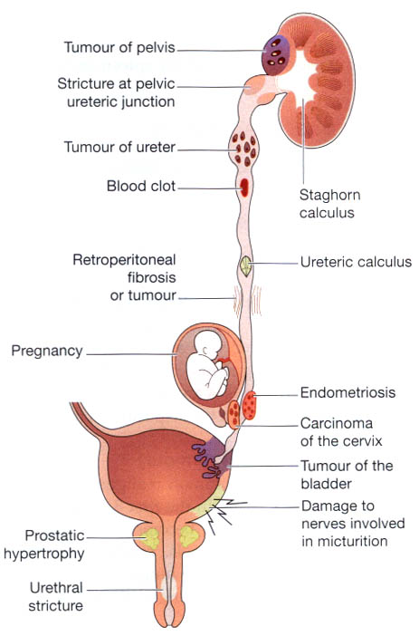
Fig: Summary of obstructions of the urinary tract.

Slide 85
Hydronephrosis refers to dilation of the renal pelvis and calyces, with accompanying atrophy of the parenchyma, caused by obstruction to the outflow of urine.
The obstruction may be sudden or insidious, and it may occur at any level of the urinary tract, from the renal pelvis to the urethra.
The most common causes are categorized as follows:
Congenital:
Atresia (congenital absence or narrowing of opening) of the urethra
Valve formations in either ureter or urethra
Aberrant (abnormal) renal artery compressing the ureter
Renal ptosis (mobile or ‘floating’ kidney instead of being fixed) with torsion
Kinking or twisting of the ureter

Slide 86
Acquired
Foreign bodies: calculi, necrotic papillae
Proliferative lesions: benign prostatic hyperplasia, carcinoma of the prostate, bladder tumors, contiguous malignant disease (carcinoma of the cervix or uterus)
Inflammation: prostatitis, ureteritis, urethritis
Neurogenic: spinal cord damage with paralysis of the bladder
Normal pregnancy: mild and reversible
Hydronephrosis may be:
Unilateral Hydronephrosis
This occurs due to some form of ureteral obstruction at the level of pelvi-ureteric junction (PUJ).
Bilateral Hydronephrosis
This is generally the result of some form of urethral obstruction.

Slide 87
Morphologic Features
Grossly,
The kidneys may have moderate to marked enlargement.
Initially, there is extrarenal hydronephrosis characterised by dilatation of renal pelvis medially in the form of a sac.
As the obstruction persists, there is progressive dilatation of pelvis and calyces and pressure atrophy of renal parenchyma.
Eventually, the dilated pelvi-calyceal system extends deep into the renal cortex so that a thin rim of renal cortex is stretched over the dilated calyces and the external surface assumes lobulated appearance.
This advanced stage is called as intrarenal hydronephrosis

Slide 88
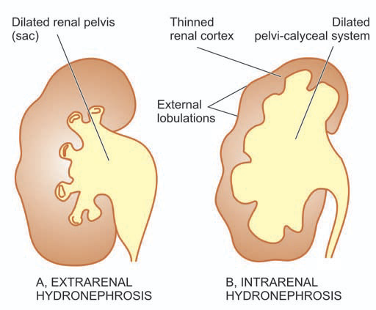
Fig: Hydronephrosis, stages in its evolution.

Slide 89
Microscopically,
The wall of hydronephrotic sac is thickened due to fibrous scarring and chronic inflammatory cell infiltrate.
There is progressive atrophy of tubules and glomeruli along with interstitial fibrosis.
Stasis of urine in hydronephrosis causes infection and inflammation of renal pelvis (pyelitis) resulting in filling of the sac with pus, a condition called pyonephrosis.

Slide 90
Tumors of kidney

Slide 91
Tumors of kidney
Both benign and malignant tumours occur in the kidney, the latter being more common.
These may arise from:
Renal tubules (adenoma, adenocarcinoma or renal cell carcinoma),
Embryonic tissue (mesoblastic nephroma, Wilms’ tumour or Nephroblastoma),
Mesenchymal tissue (angiomyolipoma, medullary interstitial tumour (fibroma))
Epithelium of the renal pelvis (urothelial carcinoma).

Slide 92
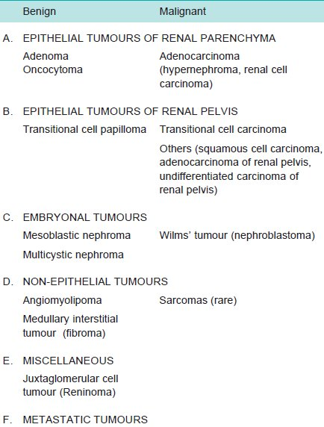
Table: Classification of Kidney Tumours.

Slide 93
Benign Tumours
Benign renal tumours are usually small and are often an incidental finding at autopsy or nephrectomy.
Cortical Adenoma
More common than other benign renal neoplasms.
Frequently multiple and associated with chronic pyelonephritis or benign nephrosclerosis.
Grossly, tiny nodules up to 3 cm in diameter. Encapsulated and white or yellow.
Microscopically, composed of tubular cords or papillary structures projecting into cystic space.
Cells of adenoma are usually uniform, cuboidal with no atypicality or mitosis.
Larger than 3 cm in diameter are potentially malignant and metastasising.

Slide 94
Oncocytoma
Oncocytoma is a benign epithelial tumour arising from collecting ducts.
Grossly, the tumour is encapsulated and has variable size.
Cut section is homogeneous and has characteristic mahogany-brown or tan colour.
Microscopically, the tumour cells are plump with abundant, finely granular, acidophilic cytoplasm and round nuclei.
Electron microscopy demonstrates numerous mitochondria in the cytoplasm.

Slide 95
Other Benign Tumours
Angiomyolipoma is a hamartoma (overgrowth of mature tissue) of the kidney that contains differentiated tissue element derived from blood vessels, smooth muscle and fat.
Mesoblastic nephroma is a congenital benign tumour.
Multicystic nephroma is another uncommon tumour of early infancy.
Medullary interstitial cell tumour is a tiny nodule in the medulla composed of fibroblast-like cells in hyalinised stroma. These tumours used to be called renal fibromas.
Juxtaglomerular tumour or reninoma is a rare tumour of renal cortex consisting of sheets of epithelioid cells with many small blood vessels. The tumour secretes excessive quantities of renin and, thus, the patients are likely to have hypertension.

Slide 96
Malignant tumors:
Adenocarcinoma of Kidney (Synonyms: Renal cell carcinoma, Hypernephroma, Grawitz tumour):
Adenocarcinoma (Renal cell carcinoma; RCC) arising from tubular epithelium.
This cancer comprises 70 to 80% of all renal cancers and occurs most commonly in 50 to 70 years of age with male preponderance (2:1).
Etiology
Tobacco
Genetic factors
Cystic diseases of the kidneys
Other risk factors
Exposure to asbestos, heavy metals and petrochemical products.
In women, obesity and oestrogen therapy.
Nephropathy, etc.

Slide 97
Classification
RCC has been reclassified into (as microscopic features):
Clear cell type
Papillary type
Granular cell type
Chromophobe type
Sarcomatoid type
Collecting duct type

Slide 98
Morphologic Features
Grossly, RCC commonly arises from the poles of the kidney as a solitary and unilateral tumour, more often in the upper pole.
The tumour is generally large, golden yellow and circumscribed.
Papillary tumours have grossly visible papillae and may be multifocal.
Cut section of the tumour commonly shows large areas of ischaemic necrosis, cystic change and foci of haemorrhages.
Another significant characteristic is the frequent presence of tumour thrombus in the renal vein which may extend into the vena cava.

Slide 99
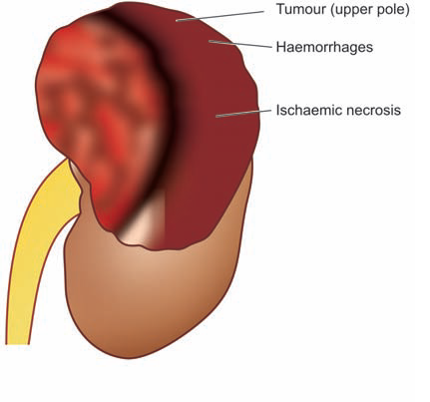
Fig: Renal cell carcinoma. The upper pole of the kidney shows a large and tan mass

Slide 100
Microscopically, the features of various types of RCC are as under:
Clear cell type (non-papillary): Clear cytoplasm (due to removal of glycogen and lipid during processing of tissue), well differentiated
Papillary type: Papillary pattern, tumor cells are cuboidal with small round nuclei, psammoma bodies (calcified spherules/sandlike particles) may be seen
Granular cell type: Abundant acidophilic cytoplasm, nuclear pleomorphism, hyperchromatism, marked atypia
Chromophobe type: Mixture of pale clear cells with perinuclear halo and granular cells, cells contains many vesicles
Sarcomatoid type: Whorls of atypical anaplastic spindle cells
Collecting duct type: Occurs in medulla, single layer of cuboidal tumour cells arranged in tubular and papillary pattern

Slide 101
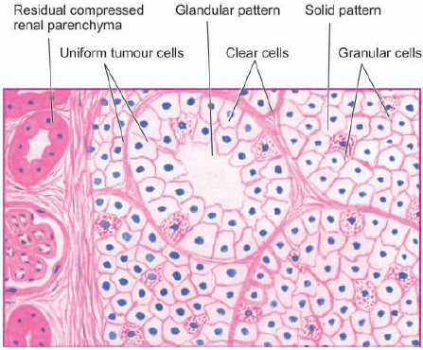
Fig: Renal cell carcinoma. The tumour shows solid masses and acini of uniform-appearing tumour cells. Clear cells predominate in the tumour while the stroma is composed of fine and delicate fibrous tissue.

Slide 102
Renal cell carcinoma
Contd….
Clinical Features:
Slow-growing tumour.
Haematuria, flank plain and palpable abdominal mass
Spread to distant sites via haematogenous route to the lungs, brain and bone, and locally to the liver and perirenal lymph nodes
Systemic symptoms of fatiguability, weight loss and intermittent fever unassociated with evidence of infection
Syndromes like polycythaemia (by erythropoietin), hypercalcaemia (by parathyroid hormone and prostaglandins), hypertension (by renin), effects of feminisation or masculinisation (by gonadotropins) and Cushing’s syndrome (by glucocorticoids).

Slide 103
Wilms’ Tumour (Synonym: Nephroblastoma)
Nephroblastoma or Wilms’ tumour is an embryonic tumour derived from primitive renal epithelial and mesenchymal components. It is the most common abdominal malignant tumour of young children, seen most commonly between 1 to 6 years of age with equal sex incidence.
Etiology
Defect in chromosome 11p13.
Monozygotic twins and cases with family history.
Congenital anomalies.
Osteosarcoma, retinoblastoma, neuroblastoma, etc.

Slide 104
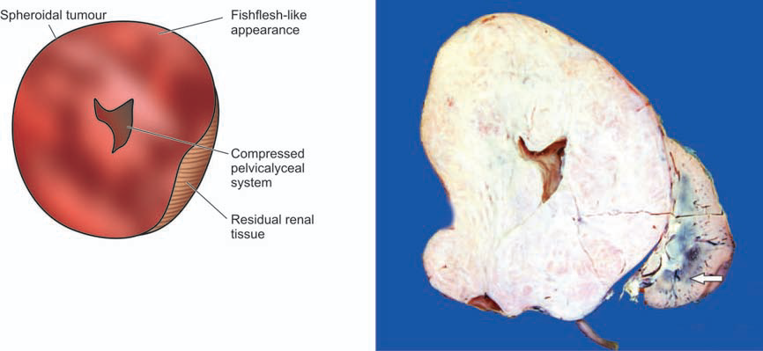
Morphologic Features
Grossly,
The tumour is usually quite large, spherical, replacing most of the kidney.
It is generally solitary and mostly unilateral
On cut section, soft, fishflesh-like grey-white to cream-yellow tumour with foci of necrosis and haemorrhages and grossly identifiable myxomatous or cartilaginous elements
Invasion into renal vein is grossly evident in half the cases.

Slide 105
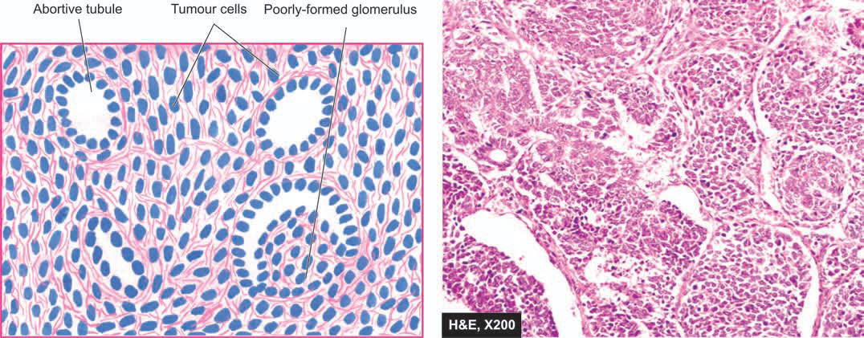
Microscopically,
Nephroblastoma shows mixture of primitive epithelial and mesenchymal elements.
Most of the tumour consists of small, round to spindled, anaplastic, sarcomatoid, tumour cells.
In these areas are present abortive or underdevelopd tubules and poorly-formed glomerular structures.
Mesenchymal elements such as smooth and skeletal muscle, cartilage and bone, fat cells and fibrous tissue, may be seen.

Slide 106
Clinical Features
The most common presenting feature is a palpable abdominal mass.
Other common abnormalities are haematuria, pain, fever and hypertension.
The tumour rapidly spreads via blood, especially to lungs.

Slide 107
Tumours of the Bladder

Slide 108
Tumours of the Bladder
Epithelial (Urothelial) Bladder Tumours /(urothelial carcinoma):
More than 90% of bladder tumours arise from transitional epithelial (urothelium) lining of the bladder in continuity with the epithelial lining of the renal pelvis, ureters, and the major part of the urethra.
Bladder cancer comprises about 3% of all cancers.
Most of the cases appear beyond 5th decade of life with 3-times higher preponderance in males than females.

Slide 109
Etiopathogenesis:
Industrial occupations: aniline dyes, rubber, plastic, textiles, and cable have high incidence of bladder cancer. Carcinogenic substances are the metabolites of β- naphthylamine and benzene
Schistosomiasis: infestation of Schistosoma haematobium of the bladder
Dietary factors: carcinogenic metabolites of tryptophan, artificial sweeteners like saccharin, coffee or caffeine and chronic alcoholism
Local lesions: a number of local lesions in the bladder
Smoking: increased urinary excretion of carcinogenic substances of tobacco
Drugs: Immunosuppressive therapy

Slide 110
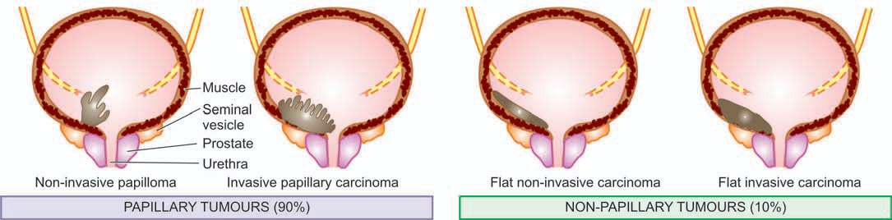
Morphologic Features
Grossly,
Urothelial tumours may be single or multiple.
About 90% of the tumours are papillary (non-invasive or invasive), whereas the remaining 10% are flat indurated (non-invasive or invasive)
The papillary tumours have free floating fern-like arrangement with a broad or narrow pedicle.
The non-papillary tumours are bulkier with ulcerated surface
More common locations for either of the two types are the trigone, the region of ureteral orifices and on the lateral walls.

Slide 111
Histologically, urothelial tumours are of 3 cell types—
Transitional cell carcinoma
Squamous cell carcinoma
Glandular carcinoma
Transitional Cell Tumours.
Approximately 90% of all epithelial tumours of the bladder are transitional cell tumours.
Transitional cell papilloma. Papillomas may occur singly or may be multiple. They are generally small, less than 2 cm in diameter, papillary with branching pattern. Each papilla is composed of fibrovascular stromal core covered by normal-looking transitional cells having normal number of layers (up to 6-7) in thickness.
Carcinoma in situ (CIS). first stage; characterised by anaplastic malignant cells confined to layers superficial to basement membrane of the bladder mucosa. May be invasive or non-invasive type
Transitional cell carcinoma (TCC). The criteria for anaplasia (loses distinctive characters) are: increased cellularity, nuclear crowding, variation in cell size and shape, variation in nuclear chromatin pattern, mitotic figures and giant cells. The criteria for invasion are: penetration of the basement membrane of bladder mucosa.

Slide 112
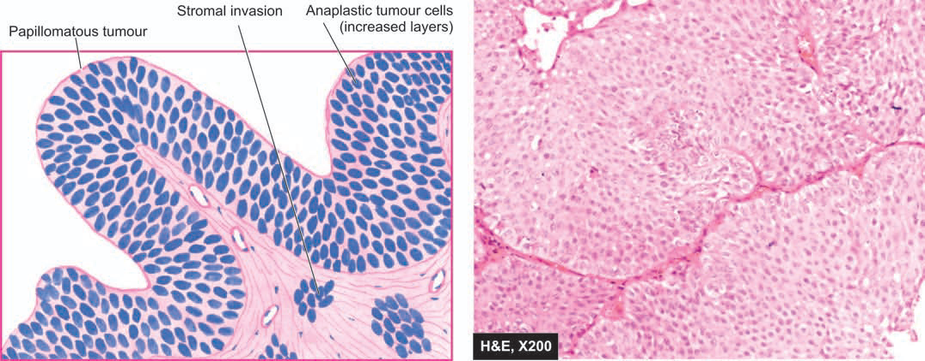
Fig: Transitional cell carcinoma; there is increase in the number of layers of epithelium.

Slide 113
Squamous Cell Carcinoma
Comprises about 5% of the bladder carcinomas.
Are sessile (w/o stalk), nodular, infiltrating and ulcerating.
Adenocarcinoma
A rare form
Characterised by glandular and tubular pattern with or without mucus production.

Slide 114
End of Renal System..!!
Thank You for your
kind attention....!!!

